Slide 1

Binary to Decimal Converter
This project demonstrates the conversion of binary numbers to decimal format using a simple circuitry and a digital display. The process involves utilizing logical gates to transform binary input into its decimal equivalent.

Slide 2
Binary to Decimal Converter
Project Overview
This project focuses on creating binary to decimal convertor to help us understand binary number system and its applications.
Importance of Conversion
Binary to decimal conversion is important in computing ,as computers wors on binary data ,while humans also uses binary numbers for understanding.
Aim
The aim is to design a reliable circuit that can accurately converts binary digits to decimal numbers.

Slide 3
Apparatus used
4 DIP Switches: 2. 7-Segment Display
Used to manually provide 4-bit binary Displays decimal numbers based on input
input to the circuit. signals by lightening specific segments.
3. 7747 Decoder: 4. Power Supply
Converts binary input into control signals A stable power supply, like batteries
for a 7-segement display. etc, is necessary to power the circuit.
Connecting wires and Breadboard 6. Resisters(220Ω & 10kΩ)
Used for making the circuit connections 200Ω Resister limits current to
and aligning the components in a 7-segement display to prevent damage
compact manner. 10kΩ Resister stable low signal when
DIP is turned off.

Slide 4
Procedure for Binary to Decimal convertor
DIP Switch setup 7447 Decoder
DIP switch provides 4-bit binary Link DIP switch outputs to
input with10kΩ resister. 7-segement Display 7447 input pins(A-D).
Connection
Connect 7447 output pins to the
Power Supply 7-segement display with 220ΩR. Testing the Output
Provide 5V regulated power Toggle DIP switches to input
to the entire circuit. binary values & displays output.
1
2
3
4
5

Slide 5
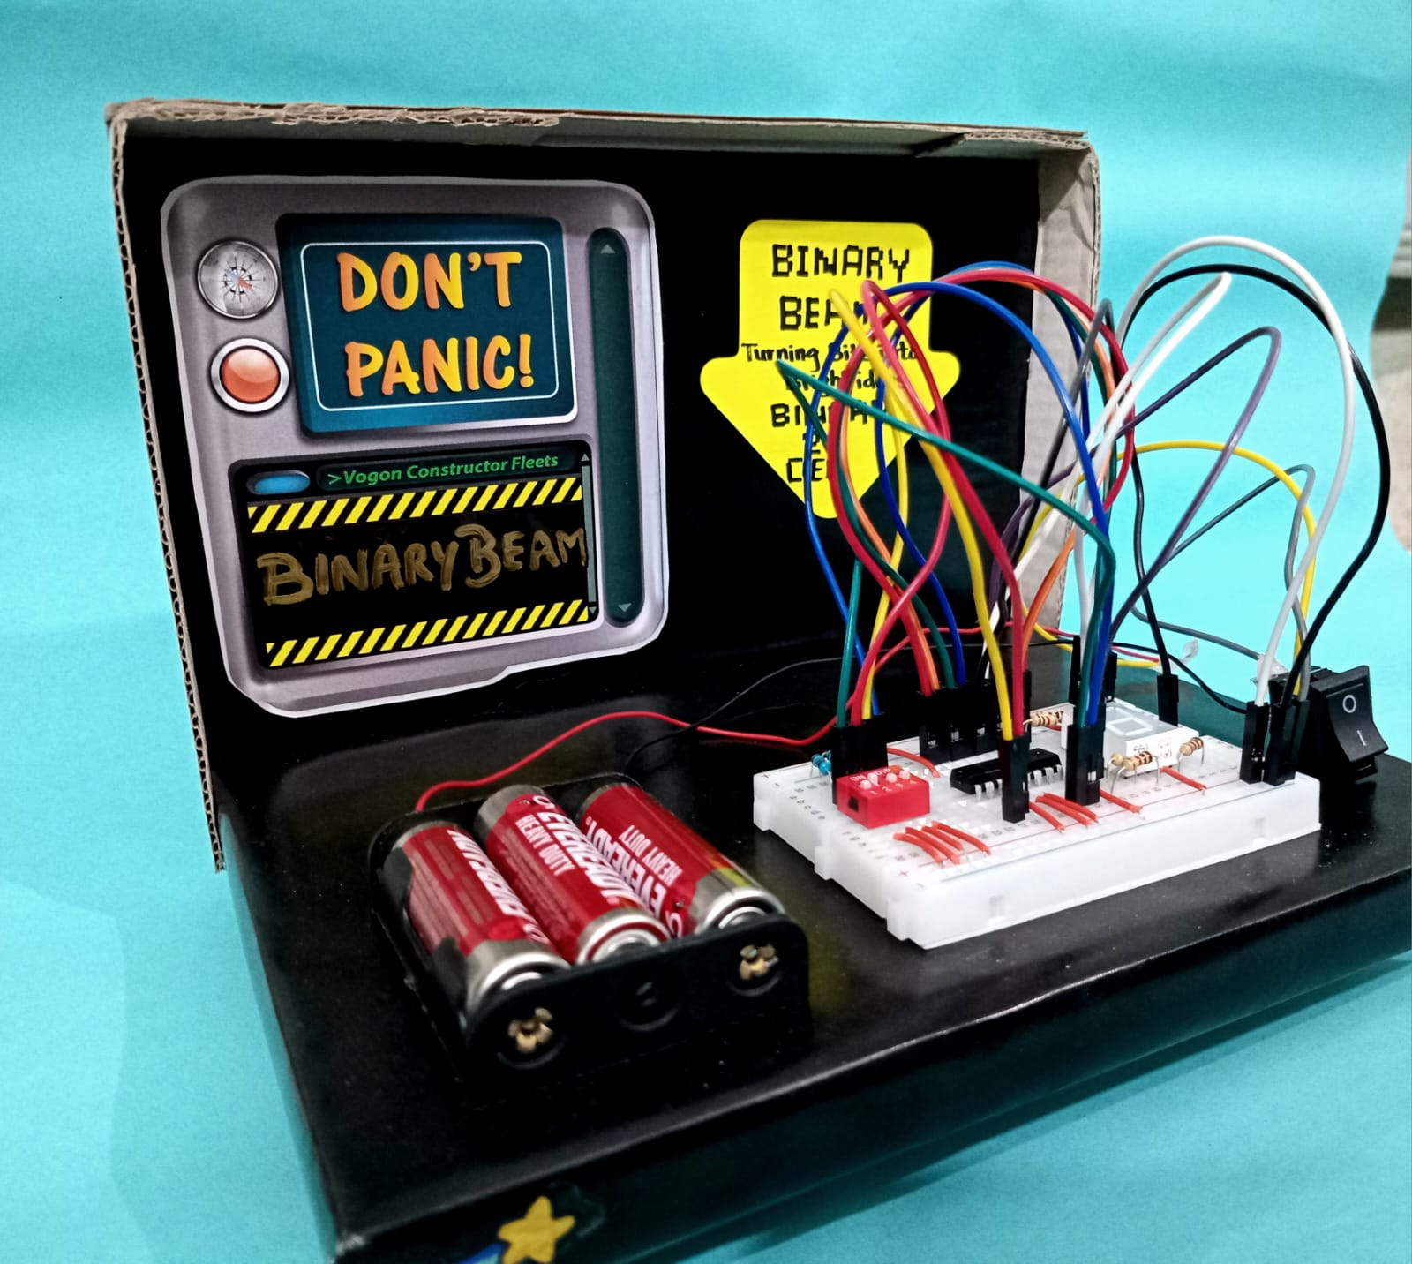
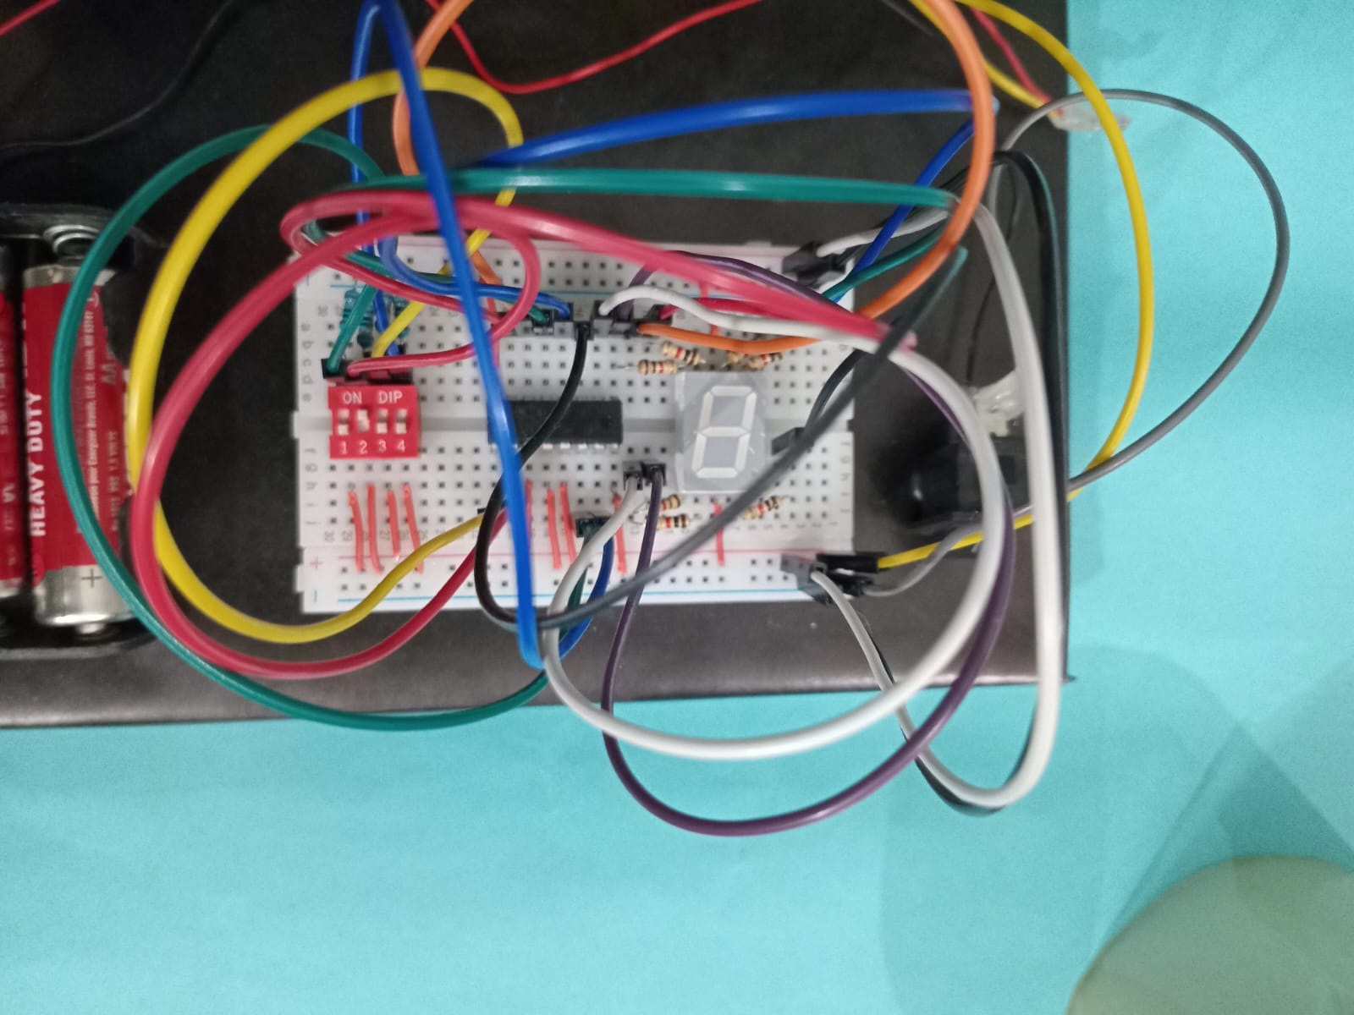
Circuit Diagram

Slide 6
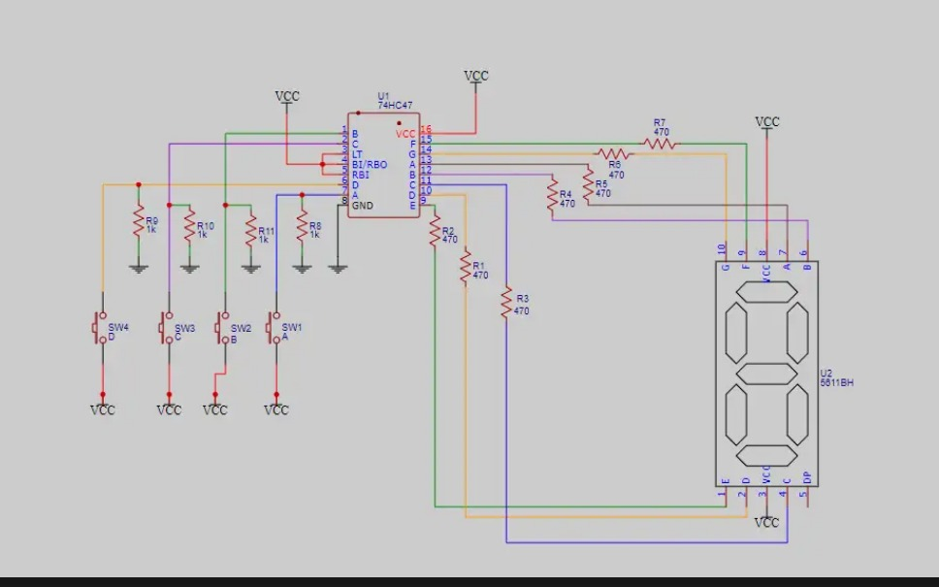
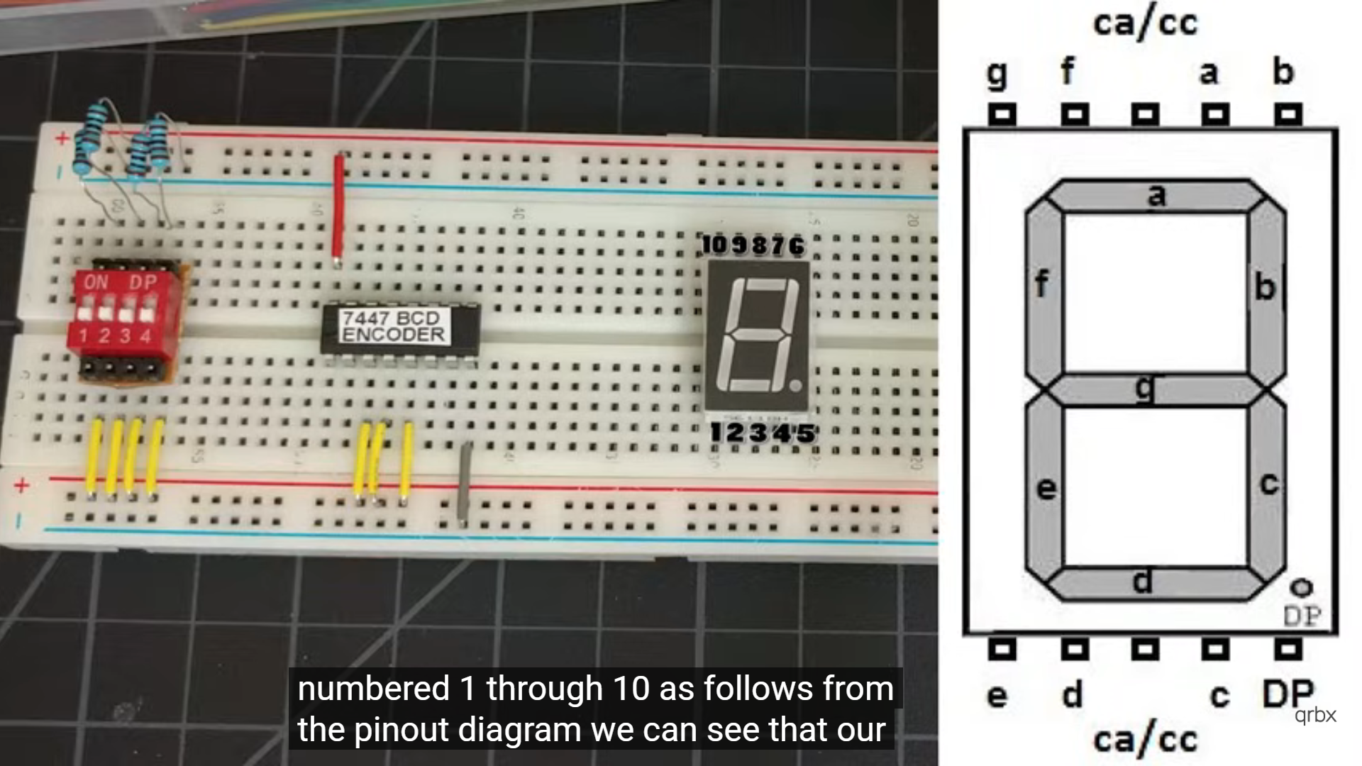
Circuit diagram

Slide 7
Circuit Diagram Components Functionality
DIP SWITCH:
Manual binary input
7447 IC:
Decodes BCD to 7-segment
7-segment:
Displays decimal value
Resistors:
Protect and stabilize signal
Power:
Runs the entire setup

Slide 8
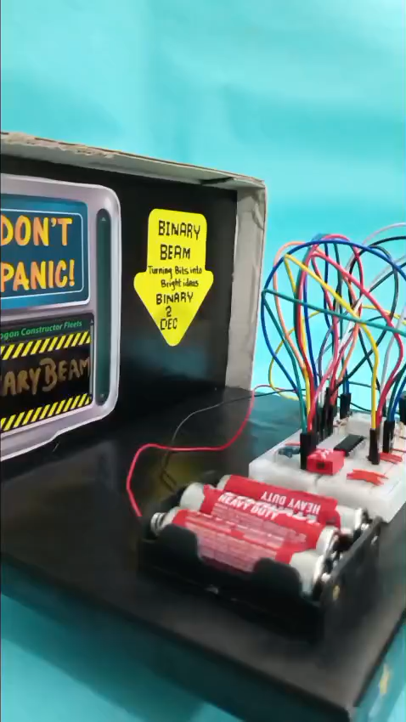
Demo Video

Slide 9
Conclusion
Successfully built a manual binary to decimal converter.
1.Project success
2.Understanding Number system
3.Future scope
4.IC & Switching Issues
Strengthened understanding of number systems and logic ICs.
Identified challenges like IC compatibility and stable switching.
microcontroller-Based systems, LCD display, extended conversions

Slide 10
Group Members
Tehreem Fatima(01-134251-091)
Iqra Agha(01-134251-026)
Meerab Hanif(01-134251-041)

